Slide 1
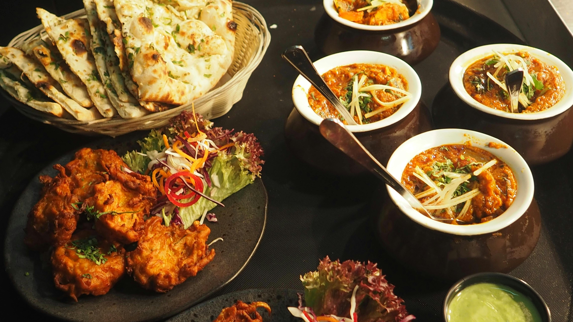

Slide 2
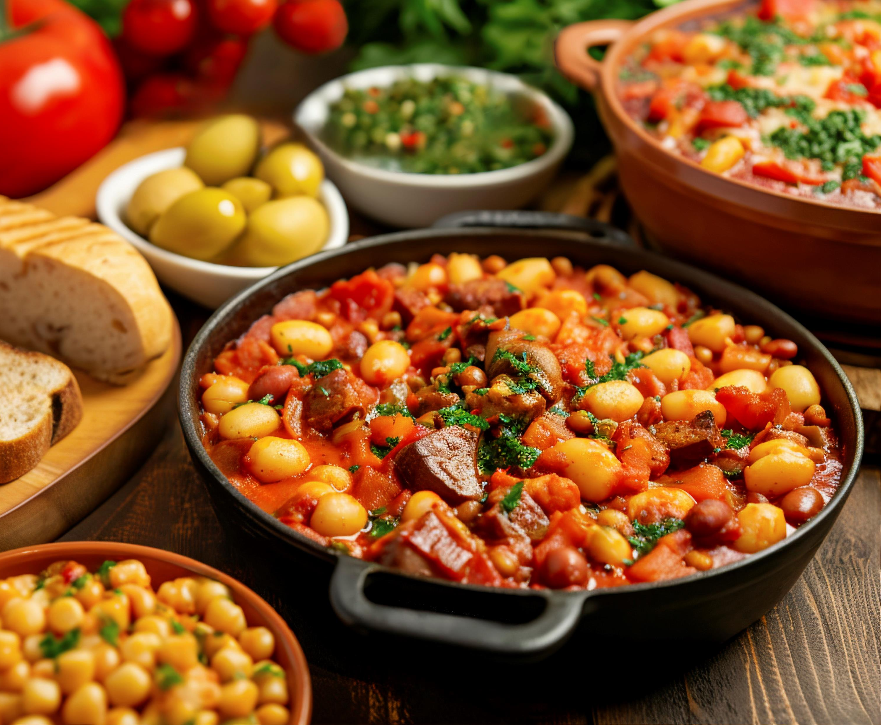

CONTENTS:
PROJECT SUMMARY
INTRODUCTION
STATEMENT OF THE PROBLEM
OBJECTIVES
SCOPE AND LIMITATION
METHODOLOGY
LITERATURE REVIEW
REQUIREMENT
FEASIBILITY
RESEARCH FINDINGS
CONCLUSION

Slide 3
PROJECT SUMMARY
Title : Foodie Heaven
Aim : To Manage Food Orders and Deliveries Efficiently
Developed at : New Summit College
Team Member : Anish Chauhan
Development Platform : Android
Front-end-tool : XML, Android Studio
Back-end-tool : Firebase

Slide 4

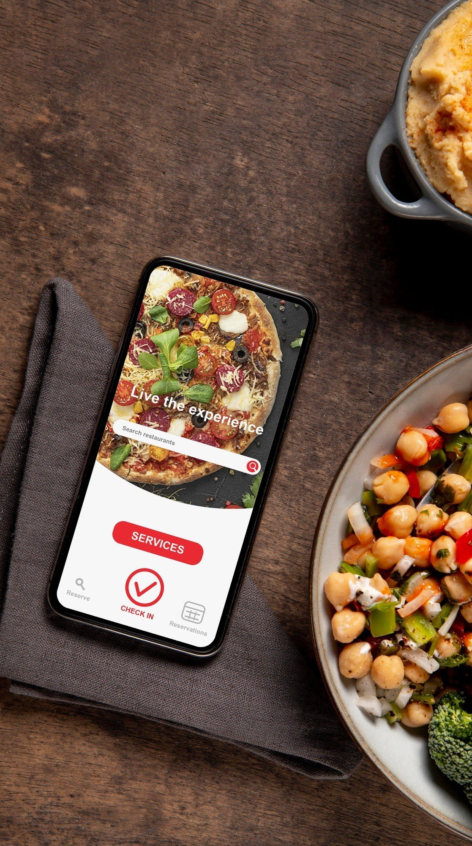
INTRODUCTION
Foodie Heaven is a digital platform for ordering food & groceries online.
Suitable for restaurants, fast food chains, and home kitchens.
Customer can search for the availability of foods at any moment.
This app aims to address the growing demand for convenient and flexible food delivery services.
Firebase for backend services, ensure data security, minimize loss of data.
Payment options are flexible , allowing online payment via credit/debit card or cash on pickup.

Slide 5

STATEMENT OF THE PROBLEM
In the fast-paced world we live in, people often lack the time to prepare meals at home and rely heavily on food delivery services .
Traditional methods of ordering food can be inefficient and time-consuming, leading to frustration for both customers and food service providers.
There is a need for a user-friendly app that allows users to order food conveniently and specify delivery times according to their schedules.

Slide 6

OBJECTIVES
To Develop a mobile application with an intuitive and easy-to-navigate interface. Reduce restaurant's food wastage.
Provide timely notifications to users about order status, delivery times, and promotional offers.
To Allow users to specify desired delivery times, ensuring that their food arrives exactly when they need it.

Slide 7
SCOPE AND LIMITATION
Limitations:
Higher maintenance costs for backup and storage.
limited geographical area and may include a selected list of restaurants for easier integration.
The app might initially offer a limited range of delivery time slots to ensure smooth operations.
Scope :
User registration and login
Browsing restaurant menus with pictures and descriptions
Placing orders and selecting desired delivery time slots within a reasonable timeframe.
Real-time order tracking
Basic user reviews and restaurant ratings

Slide 8


LITERATURE REVIEW
Foodmandu
Bhojdeals

Slide 9
FUNCTIONAL REQUIREMENT
The customers should be able to register and login into the system.
Users can rate their experience and provide feedback.
Users should be able to browse restaurants, view menus, and place orders.
The admin shall be able to update, edit and view the order status.

Slide 10
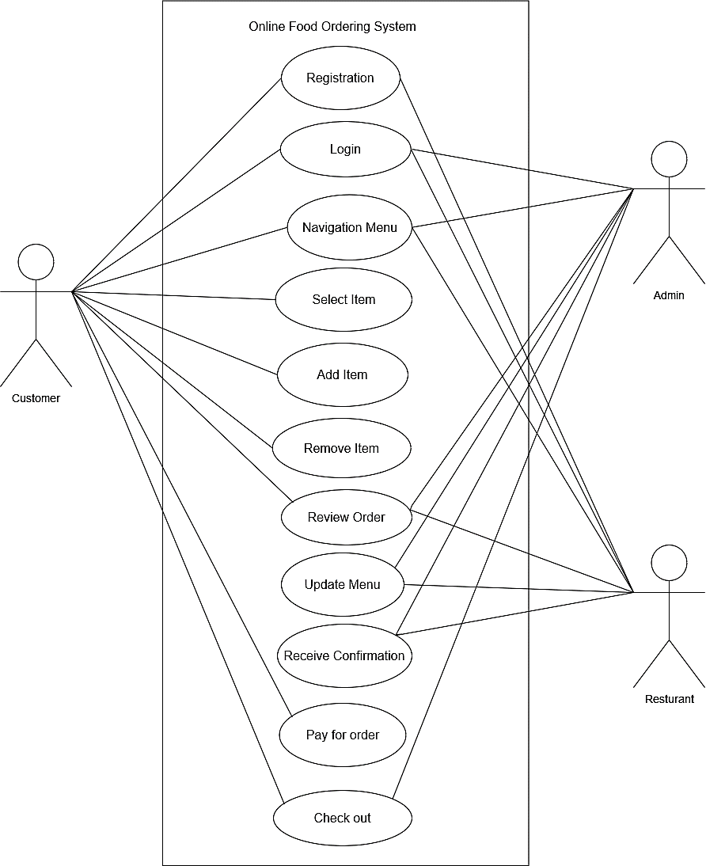
Use Case Diagram of Online Food Ordering

Slide 11
NON-FUNCTIONAL REQUIREMENT
The system is secure which lets only authentic users.
Simple, user-friendly, and attractive to users.
The architecture of this system is highly optimized and well managed.
It is a light application that uses minimum bandwidth and provides high-speed accessibility.

Slide 12
FEASIBILITY ANALYSIS
Technical Feasibility :
Developed using Java or Kotlin for Android. Hardware and software readily available.
Operational Feasibility:
User Friendly design.
Easy to use for customers and admins.
Economical Feasibility:
Minimal cost

Slide 13
GANTT CHART
Working Time | 8th July | 14th June | 21st July | 25th Aug | 30thAug | 7th Sept
Plan
System Design
Coding
Implementation
Deploy
Documentation

Slide 14
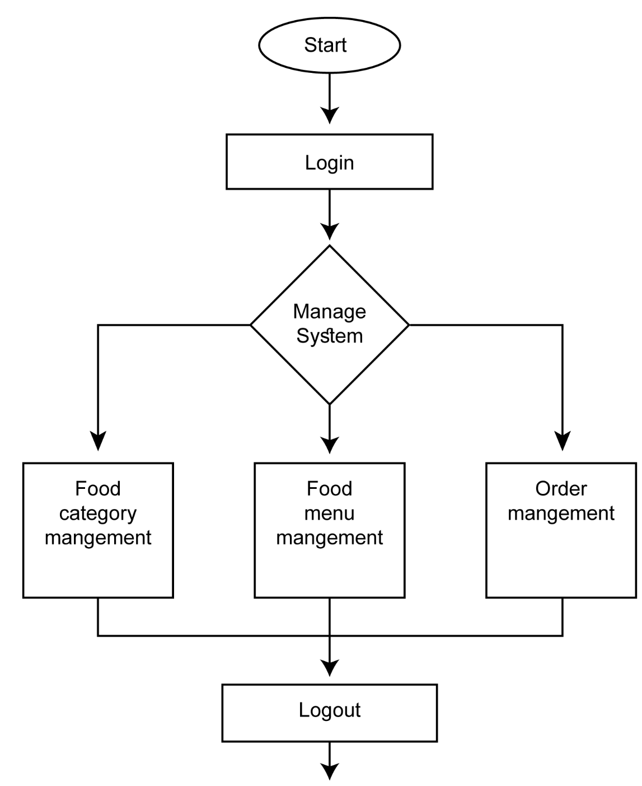
Admin workflow Process

Slide 15
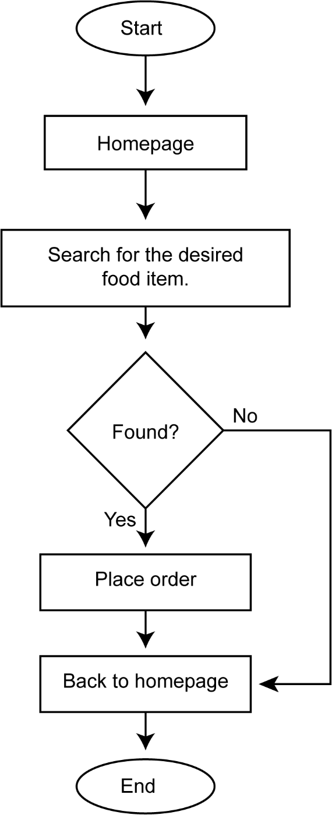
Customer Workflow Process

Slide 16
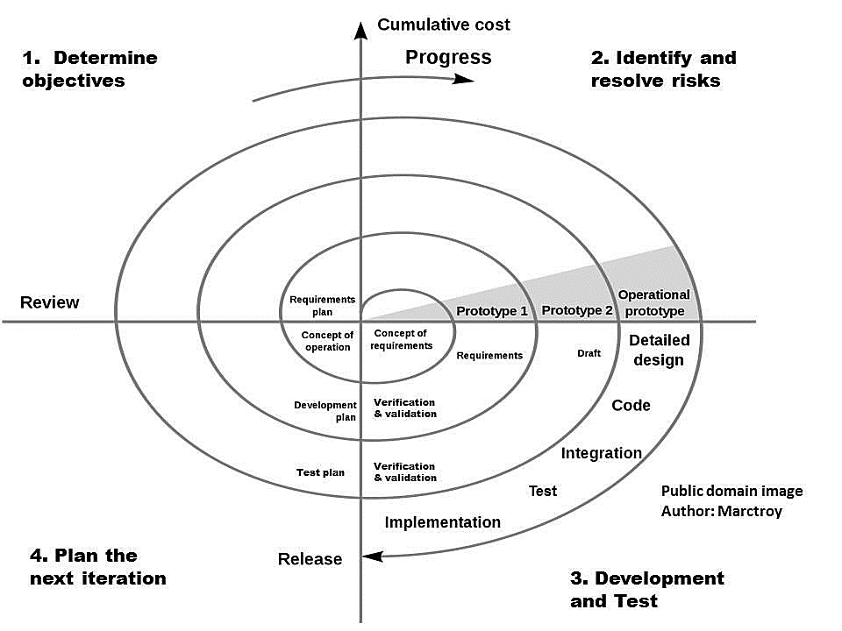
METHODOLOGY
Spiral model used as development methodology.
Iterative development.
Early risk identifying and risk management.
Adapts to changing requirement providing Flexibility.
Create and refine prototype in each cycle.
Address complex features over multiple iterations.

Slide 17

CONCLUSION
Used modern technologies : Android Studio, Java, Kotlin and Firebase.
Addresses limitations of Traditional Ordering System.
Enhances convenience for customers and restaurant admins.
Meets user specifications and market needs.
Potential for future enhancements and market growth.

Slide 18

OUTCOME
Creation of a seamless platform for managing food orders and deliveries.
Implementation of an intuitive and user-friendly interface for enhanced user experience.

Slide 19
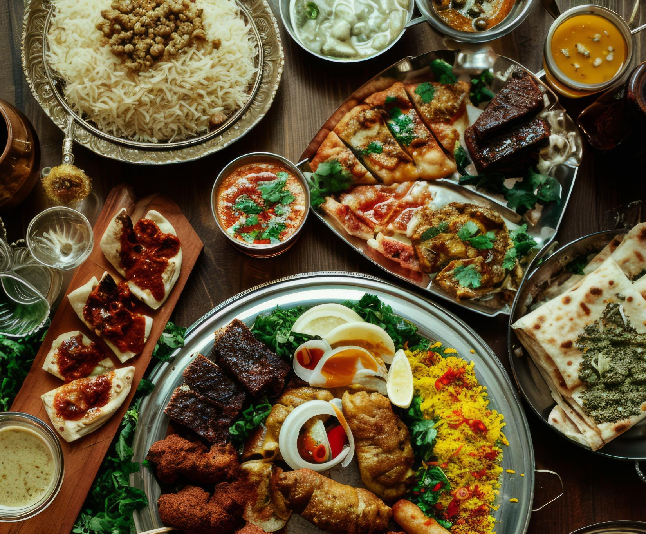

THANK
YOU
ORDER RIGHT NOW

